Slide 1
Kaggle训练营

Slide 2
Ensemble Method
So far, our statistical project has been: 1) I gather a bunch of data, 2) clean the data 3) I think really hard, then make a single, large, complicated prediction model 4) I test the predictor on data
Ensembles methods use collections of models to get better
predictive performance than any single model
get a collection of predictive models
the ensemble predictor is a weighted average of the underlying models
Why ensemble methods are better?
simple models have a limited hypothesis space
if we average lots of different simple models, we can fit these well and have a large hypothesis space and we can reduce the variance of the estimator
Why ensemble methods are better?
Bagging
Boosting

Slide 3
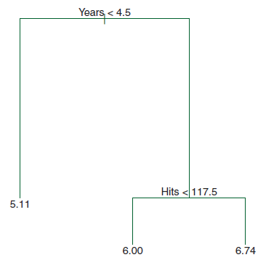
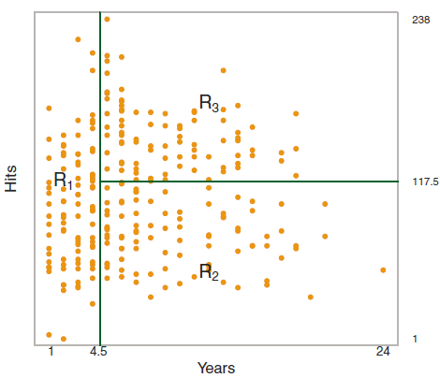
Bagging (Boostrap aggregating)
Tree Model
Trees are flexible model, good for regression and classification. They tend to fit t well, but often do not have the best predictive error. They are also unstable

Slide 4
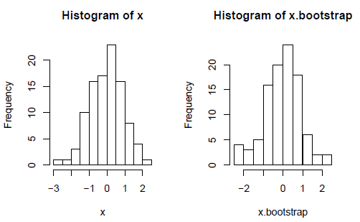
Bagging (Boostrap aggregating)
Bagging idea:
to get a set of trees, randomize the data
use bootstrapping to get new datasets
in bootstrapping, we create a new dataset by sampling with replacement from our current dataset
do this K times
Fit a tree to every new dataset
new estimator is average of bootstrap estimators

Slide 5
Boosting
A strong learner is a method that can learn a decision rule arbitrarily well.
A weak learner is a simple method that does better than guessing, but cannot learn a decision rule arbitrarily well.
Boosting: combine weak learners to make a strong learner
Start with a weak learner
Call this weak learner repeatedly, each time with new sets of the data
The sets come from random samples of the data with different weighting of each data
Higher weights on data that have been previously misclassied or high regression errors
Next iteration of the weak learner try to improve prediction on those data with bad prediction previously
The final predictor is a weighted average of the weak learners

Slide 6
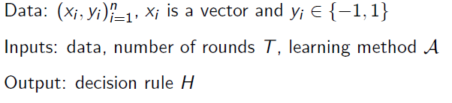
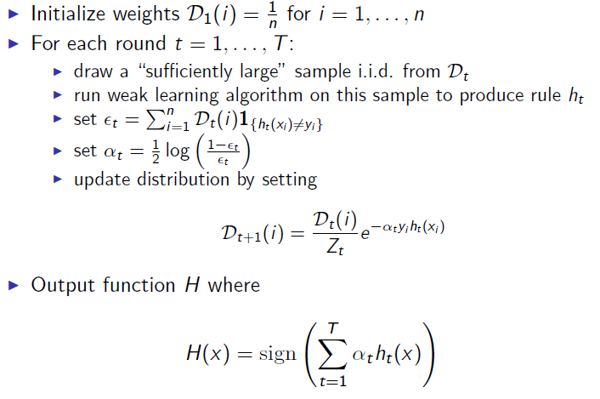
Adaboost (Adaptive Boosting)
First generation of boosting algorithm
Algorithm

